Slide 1






MISCUG PowerShell App Deployment Toolkit
Chris Thomas
Desktop engineer - Ingham ISD
Cthomas@inghamisd.org
@Automatemystuff
https://tiny.cc/MISCUG-PADT

Slide 2
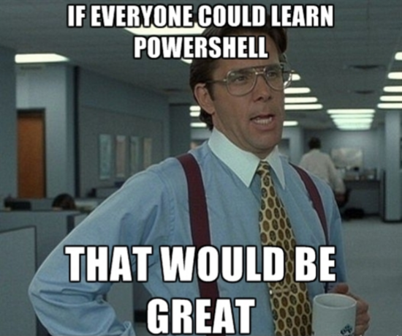
Session Description
Even if you're just starting to learn PowerShell, you can use this powerful toolkit and it’s array of functions to automate and self-document your application installations or workstation tweaks. Sure, SCCM can take an MSI and make your life easier, but what if that teacher wants the shortcut moved or the uninstaller removed from the start menu. PADT can help make your life even easier by enabling you to have better interaction with your users, simplify your deployment tasks and standardize your deployment methodology. I challenge everyone to replace command prompt with PowerShell and not to rely on aliases in the beginning.
Right-click taskbar
Select Properties
Select Navigation tab
Check "Replace Command Prompt with Windows PowerShell..."
Click OK

Slide 3
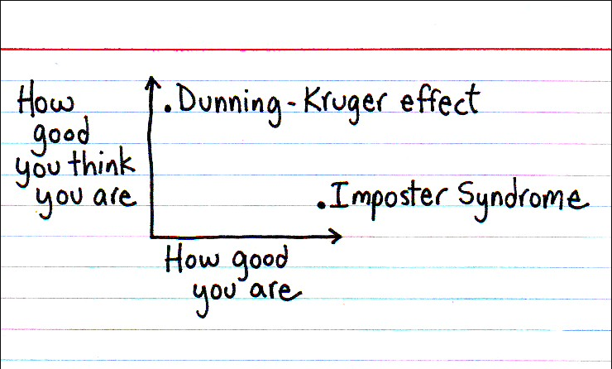
Who Am I?
Past Presentations
2013 MAEDS Fall Conference Attended ‘Marketing Yourself’ by Kris Young and Kevin Galbraith “Our Name, Reputation and Skill Sets Need to be KNOWN”
2014 MAEDS Spring PD Day First time presenting and it’s a ‘ConfigMgr panel’ for a half day session.
2014 MAEDS Fall Conference Presented ‘PADT and SCCM’
2015 MAEDS Spring PD Day Presented ‘ConfigMgr panel’ for a half day session.
2015 MAEDS Fall Conference Presented ‘Automate ALL THE THINGS with PowerShell App Deployment Toolkit’
2017 MAEDS Fall Conference Presented ‘PowerShell – Intro session for those that have been too afraid to take the plunge’
2018 MAEDS Fall Conference Presented ‘PowerShell - Intermediate Session for Those That Overcame Their Fears and Took the Plunge’
2019 MACUL Pre Con Workshop Presented ‘Office 365 Admin Training’
20 Years In K12 Technology
Intern, Tech, Coordinator, Engineer
Lifelong Learner
/r/sysadmin, /r/k12sysadmin, RSS feeds
Relentlessly Inquisitive
Let’s Ask The WinAdmins Slack
Problem Solver
Professional Googler
Voracious Reader
docs.microsoft.com
Community Minded
MAEDS, MISCUG, WMISMUG, MMS
#ImpostorSyndromeBeDamned
Own what you know. Be confident, not arrogant. Ask questions. Be wrong. But don’t be silent, and don’t think you don’t belong in the group.

Slide 4

Be The Master
“Teaching does not always feel rewarding. It doesn’t need to be. It is a repayment of something that was done for you. It is not a good thing that you do; it is an obligation that you have.”
https://donjones.com/2017/10/19/become-the-master-or-go-away/

Slide 5
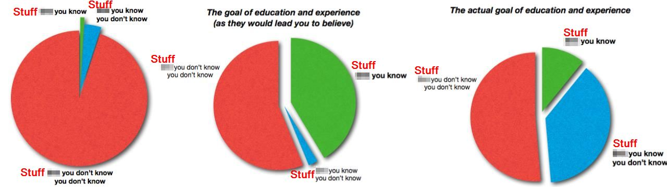
Wisdom and the Art of Being Not Dangerous
No One Knows What the F*** They’re Doing (or “The 3 Types of Knowledge”) Steve Schwartz • May 13, 2010 https://www.bridge-global.com/blog/3-types-of-knowledge/

Slide 6
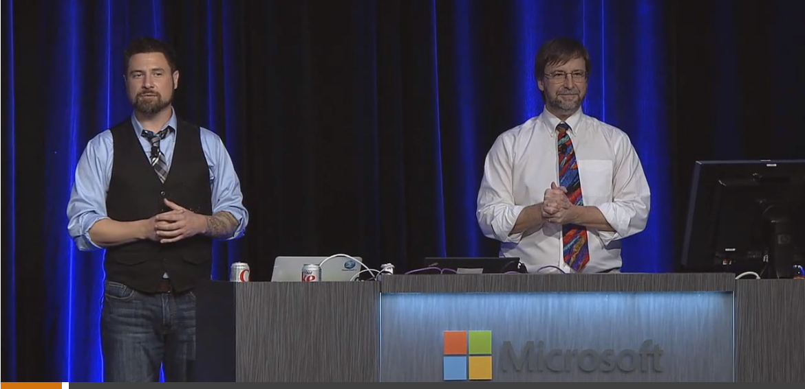
There’s a struggle to it and that’s normal
Don Jones: “If you’re not willing to play a little bit you’ll probably not be successful at PowerShell.”
Jeffrey Snover: “I’m a Distinguished Engineer, I’m the Lead Architect with Windows Server and System Center Datacenter, and I invented the dang thing and still there’s a struggle to it and that’s normal.
Windows PowerShell Unplugged with Jeffrey Snover & Don Jones TechEd North America 2014 • (1hr 16min • quotes @ 3:15) https://channel9.msdn.com/Events/TechEd/NorthAmerica/2014/DCIM-B318

Slide 7
Vocabulary – 01/02
Shell: the command interpreter that is used to pass commands to the operating system
ISE: the Integrated Scripting Environment is an application where you can run, test, and debug scripts in a single GUI with tab completion, syntax coloring, selective execution, and context-sensitive help
Cmdlet: a task-oriented command that is typically used to return a .NET Framework object to the next command in the pipeline
Variable: a name given to stored information, e.g. $users, $iWishYouHadAStrongPassword, $x
Parameter: input values or arguments used by the cmdlet or script to make it more dynamic
Named:
Positional:
Switch:
Object: a representation of something with methods to take actions against it and properties to access information stored within it

Slide 8
Vocabulary – 02/02
Module: a set of related Windows PowerShell functionalities, grouped together as a convenient unit (usually saved in a single directory)
Script Module: a file (.psm1) that contains PowerShell code for functions, variables and more
Binary Module: a .NET Framework assembly (.dll) that contains compiled code
Dynamic Module: a module that only exists in memory (Import-PSSession)
Pipeline ( | ): a method to send the results of the preceding command as input to the next command
$_: “the current object in the pipeline", or "this", or $PSItem
PSSession: a persistent connection to a local or remote computer that is created, managed and closed by the user
PSDrive: a virtual drive that provides direct access to a data store (file system, registry, certificate store, SCCM)
Function: a command or series of commands grouped to run together
Alias: shortcut to a command, cmdlet or function
Tab Completion: the ability to complete cmdlet names, parameters, file paths, file names, etc with the use of the tab key

Slide 9


Slide 10

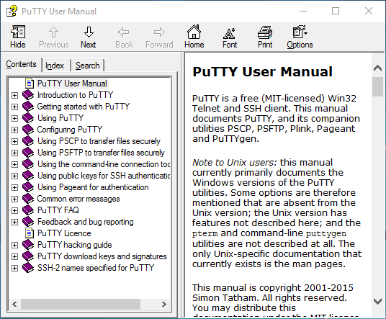
Remember Microsoft Compiled HTML Help Files?
C
H
M
putty.chm

Slide 11
G E T -
C
H
M
OMMAND
ELP
EMBER
ODULE

Slide 12
Get-Command
PS C:\> Get-Command -Module <moduleName>
PS C:\> Get-Command -Verb Get
PS C:\> Get-Command -Verb Get -Noun P*
PS C:\> Get-Command Get-P*
PS C:\> Get-Command Get-P* -Module Microsoft.PowerShell.Utility
PS C:\> Get-Command Get-P* -Module Microsoft.PowerShell.Management
ALIAS: gcm
SYNOPSIS: Gets all commands.

Slide 13
Get-Help
PS C:\> Get-Help <cmdlet> -Examples
PS C:\> Get-Help <cmdlet> -Full
PS C:\> Get-Help <cmdlet> -ShowWindow
PS C:\> Get-Help <cmdlet> -Online
PS C:\> Get-Help <cmdlet> | Clip
Cheat Mode For Slide Prep
PS C:\> Get-Help <cmdlet> | Select-Object -ExpandProperty Synopsis | Clip
ALIAS: help, man
SYNOPSIS: Displays information about Windows PowerShell commands and concepts.

Slide 14
Get-Member
PS C:\> <cmdlet> | Get-Member
Caveat
PS C:\> Get-ADUser cthomas | Get-Member
vs.
PS C:\> Get-ADUser cthomas -Properties * | Get-Member
ALIAS: gm
SYNOPSIS: Gets the properties and methods of objects.

Slide 15
Get-Module
PS C:\> Get-Module
PS C:\> Get-Module -ListAvailable
PS C:\> $session_DC1 = New-PSSession -ComputerName V-DC1 PS C:\> Get-Module -PSSession $session_DC1 -ListAvailable
ALIAS: gmo
SYNOPSIS: Gets the modules that have been imported or that can be imported into the current session.

Slide 16

Why PowerShell App Deployment Toolkit?
• Consistent Deployments • Self-Documenting • Pre-Built Logging • Pre-Built User Interface • Custom Branding • Pre-Built Functions and Variables • Extensible With Custom Functions • SCCM Integration • Over 10,000 Lines Of Code, FREE! • Responsive Developers • Good Documentation • Active Release Schedule

Slide 17

PowerShell App Deployment Toolkit
PowerShell App Deployment Toolkit Main Page http://psappdeploytoolkit.com/ PSAppDeployToolkit 3.7.0 Direct Download https://github.com/PSAppDeployToolkit/PSAppDeployToolkit/releases/download/v3.7.0/PSAppDeployToolkit_v3.7.0.zip Discussion Boards https://discourse.psappdeploytoolkit.com/ Authors Seán Lillis • twitter.com/seanels Dan Cunningham • twitter.com/sintaxasn

Slide 18

PowerShell App Deployment Toolkit Shoutouts
Become the Hero of the Day - Master ConfigMgr 2012 R2 with a Limited Budget and Free Community Tools System Center Universe 2014 • (47min • mentioned @ 36:00) Kent Agerlund • twitter.com/agerlund • blog.coretech.dk/author/kea • https://www.youtube.com/watch?v=9hDFqcPjjSA Microsoft System Center Configuration Manager Community Jewels TechEd North America 2014 • (1hr 6min • mentioned @ 18:20) Jörgen Nilsson • twitter.com/ccmexec • ccmexec.com • channel9.msdn.com/Events/TechEd/NorthAmerica/2014/PCIT-B320#fbid=

Slide 19

PowerShell App Deployment Toolkit Resources
Installing Applications with PowerShell App Deployment Toolkit - Part 1 https://replicajunction.github.io/2015/04/07/installing-applications-with-psadt-part1/ Powershell App Deployment Toolkit: Getting Started https://www.youtube.com/watch?v=9bNsrP8iri4 Java Deployment with SCCM 2012 and PowerShell App Deployment Toolkit http://jengeek.blogspot.com/2014/07/java-deployment-with-sccm-2012-and.html PSAPPDEPLOYTOOLKIT: GET THE BENEFITS WITHOUT WRITING A SINGLE LINE OF POWERSHELL https://dcunningham.net/psappdeploytoolkit-get-the-benefits-without-writing-a-single-line-of-powershell/

Slide 20

App Packaging Resources
Unattended/Silent Installation Switches for Windows Apps http://unattended.sourceforge.net/installers.php Window Development System Error Codes https://msdn.microsoft.com/en-us/library/windows/desktop/ms681381.aspx net helpmsg <errorcode> http://blog.configmgrftw.com/error-codes/ Why the ConfigMgr Package model won’t go anywhere http://www.david-obrien.net/2014/04/applications-vs-packages-configmgr-package-model-wont-go-anywhere/

Slide 21
PowerShell App Deployment Toolkit Functions
Refresh-Desktop
Refresh-SessionEnvironmentVariables
Register-DLL
Unregister-DLL
Block-AppExecution
Close-InstallationProgress
Convert-RegistryPath
ConvertTo-NTAccountOrSID
Copy-File
Disable-TerminalServerInstallMode
Enable-TerminalServerInstallMode
Execute-MSI
Execute-MSP
Execute-Process
Execute-ProcessAsUser
Exit-Script
Get-DeferHistory
Get-FileVersion
Get-FreeDiskSpace
Get-HardwarePlatform
Get-IniValue
Get-InstalledApplication
Get-LoggedOnUser
Get-MsiExitCodeMessage
Get-MsiTableProperty
Get-ObjectProperty
Get-PEFileArchitecture
Get-PendingReboot
Get-RegistryKey
Get-RunningProcesses
Get-ScheduledTask
Get-ServiceStartMode
Get-UniversalDate
Get-UserProfiles
Get-WindowTitle
Install-MSUpdates
Install-SCCMSoftwareUpdates
Invoke-HKCURegistrySettingsForAllUsers
Invoke-ObjectMethod
Invoke-RegisterOrUnregisterDLL
Invoke-SCCMTask
New-Folder
New-MsiTransform
New-Shortcut
New-ZipFile
Remove-File
Remove-Folder
Remove-MSIApplications
Remove-RegistryKey
Resolve-Error
Send-Keys
Set-ActiveSetup
Set-DeferHistory
Set-IniValue
Set-MsiProperty
Set-PinnedApplication
Set-RegistryKey
Set-ServiceStartMode
Show-BalloonTip
Show-DialogBox
Show-InstallationProgress
Show-InstallationPrompt
Show-InstallationRestartPrompt
Show-InstallationWelcome
Show-WelcomePrompt
Start-ServiceAndDependencies
Stop-ServiceAndDependencies
Test-Battery
Test-IsMutexAvailable
Test-MSUpdates
Test-NetworkConnection
Test-PowerPoint
Test-RegistryValue
Test-ServiceExists
Unblock-AppExecution
Update-Desktop
Update-GroupPolicy
Update-SessionEnvironmentVariables
Write-FunctionHeaderOrFooter
Write-Log

Slide 22
PowerShell App Deployment Toolkit Variables
Toolkit Name
$appDeployToolkitName
$appDeployMainScriptFriendlyName
Script Info
$appDeployMainScriptVersion
$appDeployMainScriptMinimumConfigVersion
$appDeployMainScriptDate
$appDeployMainScriptParameters
Datetime and Culture
$currentDateTime
$currentTime
$currentDate
$currentTimeZoneBias
$culture
$currentLanguage
$currentUILanguage
Environment Variables
$envHost
$envShellFolders
$envAllUsersProfile
$envAppData
$envArchitecture
$envCommonProgramFiles
$envCommonProgramFilesX86
$envCommonDesktop
$envCommonDocuments
$envCommonStartMenuPrograms
$envCommonStartMenu
$envCommonStartUp
$envCommonTemplates
$envComputerName
$envComputerNameFQDN
$envHomeDrive
$envHomePath
$envHomeShare
$envLocalAppData
$envLogicalDrives
$envProgramFiles
$envProgramFilesX86
$envProgramData
$envPublic
$envSystemDrive
$envSystemRAM
$envSystemRoot
$envTemp
$envUserCookies
$envUserDesktop
$envUserFavorites
$envUserInternetCache
$envUserInternetHistory
$envUserMyDocuments
$envUserName
$envUserProfile
$envUserSendTo
$envUserStartMenu
$envUserStartMenuPrograms
$envUserStartUp
$envSystem32Directory
$envWinDir
Domain Membership
$IsMachinePartOfDomain
$envMachineWorkgroup
$envMachineADDomain
$envLogonServer
$MachineDomainController
$envMachineDNSDomain
$envUserDNSDomain
$envUserDomain
Operating System
$envOS
$envOSName
$envOSServicePack
$envOSVersion
$envOSVersionMajor
$envOSVersionMinor
$envOSVersionBuild
$envOSVersionRevision
$envOSProductType
$IsServerOS
$IsDomainControllerOS
$IsWorkStationOS
$envOSProductTypeName
$Is64Bit
$envOSArchitecture
Current Process Architecture
$Is64BitProcess
$psArchitecture
PowerShell And CLR (.NET) Versions
$envPSVersionTable
$envPSVersion
$envPSVersionMajor
$envPSVersionMinor
$envPSVersionBuild
$envPSVersionRevision
$envCLRVersion
$envCLRVersionMajor
$envCLRVersionMinor
$envCLRVersionBuild
$envCLRVersionRevision
Permissions/Accounts
$CurrentProcessToken
$CurrentProcessSID
$ProcessNTAccount
$ProcessNTAccountSID
$IsAdmin
$IsLocalSystemAccount
$IsLocalServiceAccount
$IsNetworkServiceAccount
$IsServiceAccount
$IsProcessUserInteractive
$LocalSystemNTAccount
$SessionZero
Script Name and Script Paths
$scriptPath
$scriptName
$scriptFileName
$scriptRoot
$invokingScript
$scriptParentPath
App Deploy Script Dependency Files
$appDeployLogoIcon
$appDeployLogoBanner
$appDeployConfigFile
$appDeployToolkitDotSourceExtensions
$xmlConfigFile
$configConfigVersion
$configConfigDate
Script Directories
$dirFiles
$dirSupportFiles
$dirAppDeployTemp
Script Naming Convention
$appVendor
$appName
$appVersion
$appLang
$appRevision
$appArch
$installTitle
$installName
Executables
$exeWusa
$exeMsiexec
$exeSchTasks
RegEx Patterns
$MSIProductCodeRegExPattern
Registry Keys
$regKeyApplications
$regKeyLotusNotes
$regKeyAppExecution
$regKeyDeferHistory
COM Objects
$Shell
$ShellApp
Log File
$logName
$logTempFolder
$configToolkitLogDir
$DisableScriptLogging
$RevertScriptLogging
Script Parameters
$deployAppScriptParameters
$appDeployMainScriptParameters
$appDeployExtScriptParameters
Logged On Users
$LoggedOnUserSessions
$usersLoggedOn
$CurrentLoggedOnUserSession
$CurrentConsoleUserSession
$RunAsActiveUser
Miscellaneous
$dpiPixels
$runningTaskSequence
$IsTaskSchedulerHealthy
$invalidFileNameChars
$useDefaultMsi

Slide 23
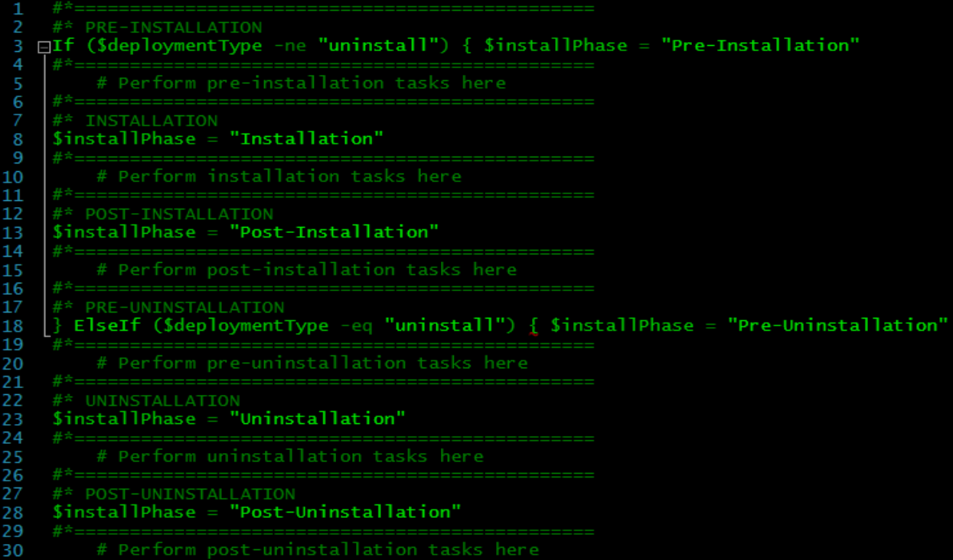
Recycled Imagery - Don’t Judge Me … I Was An AS400 Admin At The Time

Slide 24
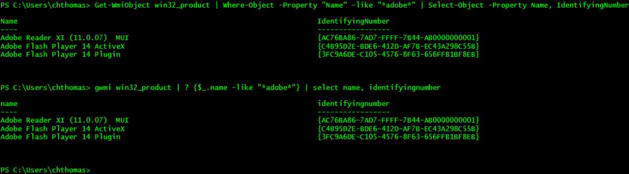
PowerShell Way Get-WmiObject win32_product | Where-Object -Property "Name" -like "*adobe*" | Select-Object -Property Name, IdentifyingNumber LazyMode Way gwmi win32_product | ? {$_.name -like "*adobe*"} | select name, identifyingnumber
How I Find Uninstall Codes … @grouppolicyguy - Darren Mar-Elia - Why Win32_Product is Bad News!

Slide 25
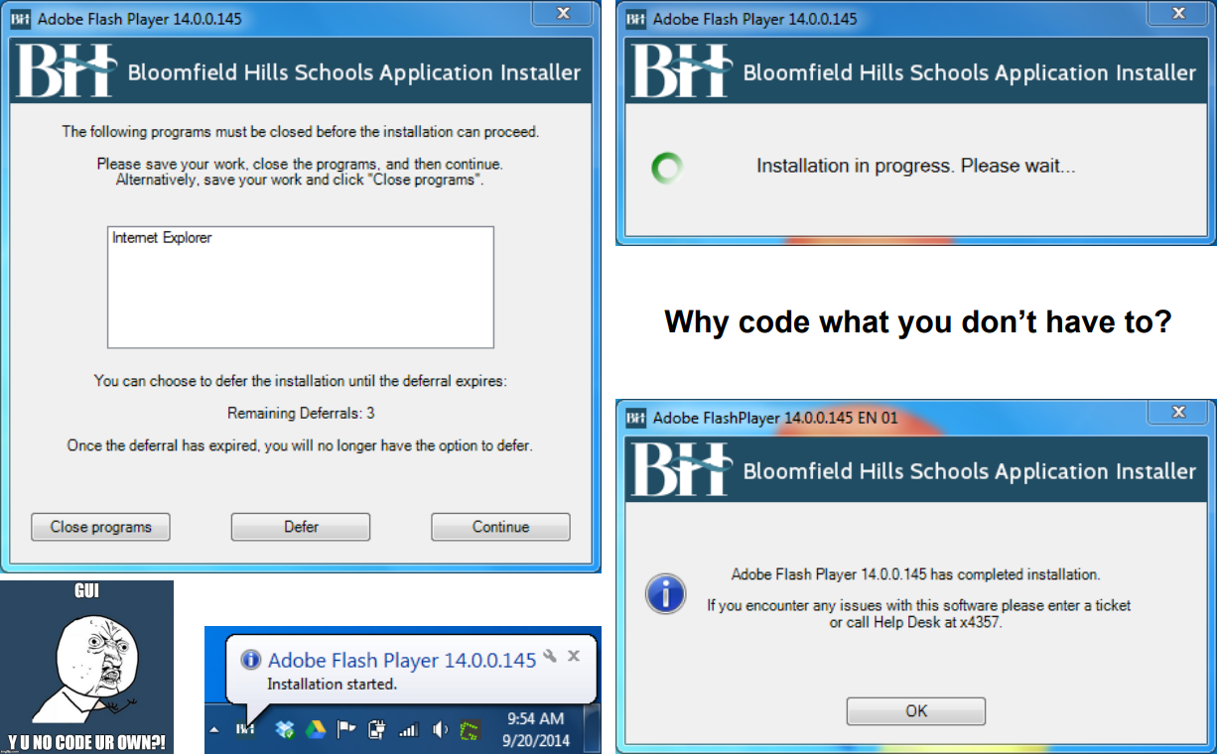


FOXDEPLOY.COM - Learning GUI Toolmaking Series

Slide 26
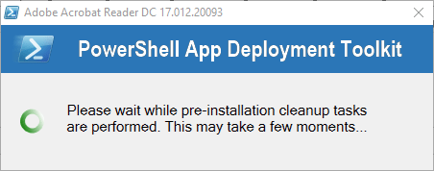
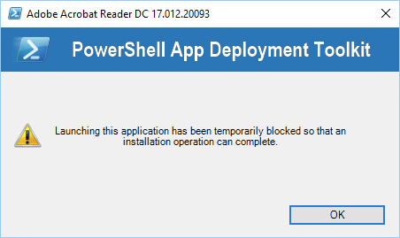
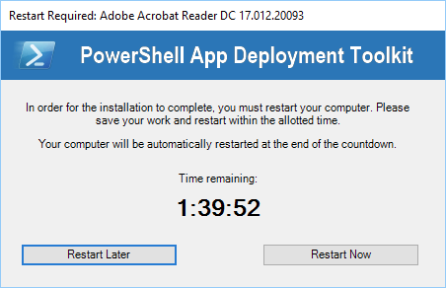
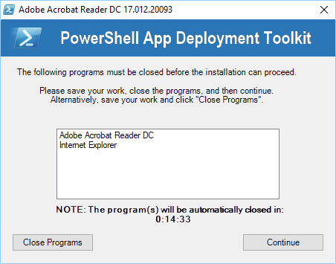
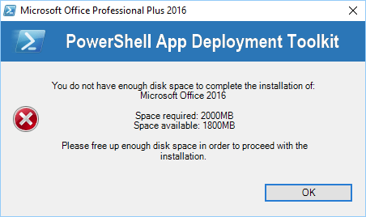
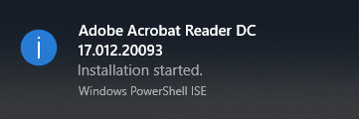
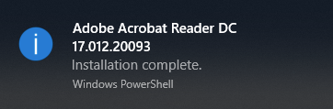

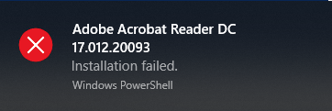

Slide 27

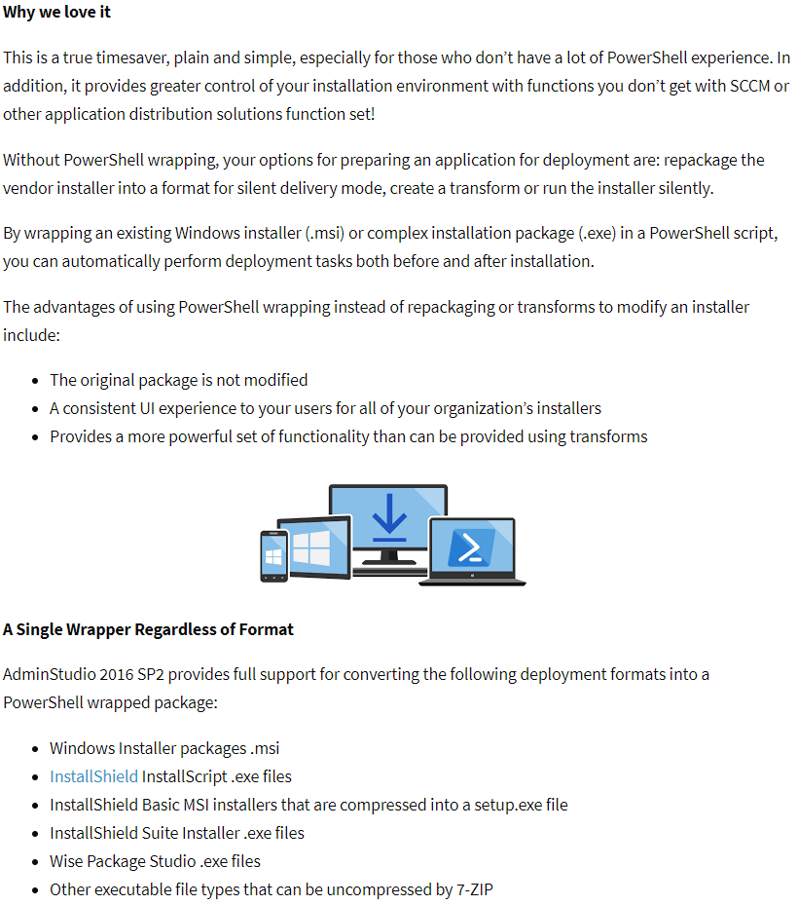

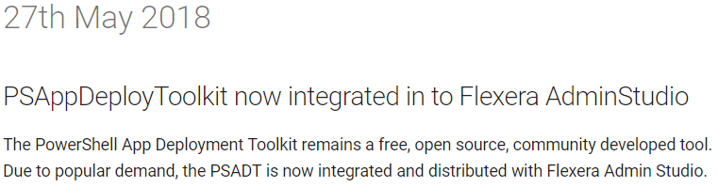

Slide 28
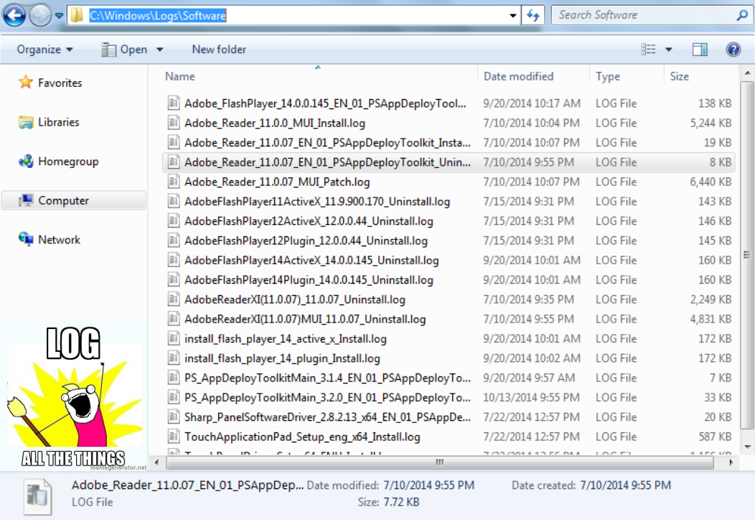
What's new in version 1806 - CMTrace installed with client - %WinDir%\ccm\cmtrace.exe

Slide 29
Import-Module For Tab Completion While Staging Applications
• Open… .\AppDeployToolkit\AppDeployToolkitMain.ps1 • Save As… .\AppDeployToolkit\AppDeployToolkitMain.psm1 • Import-Module to profile (you have a profile, right?) .\Documents\WindowsPowerShell\Microsoft.PowerShellISE_profile.ps1 • Get-Command -Module AppDeployToolkitMain • Get-Help <cmdlet/function> -Full / -Examples
My Personal <sanitized> ISE Profile - #I OWE THESE GUYS A BEER

Slide 30

Examples

Slide 31
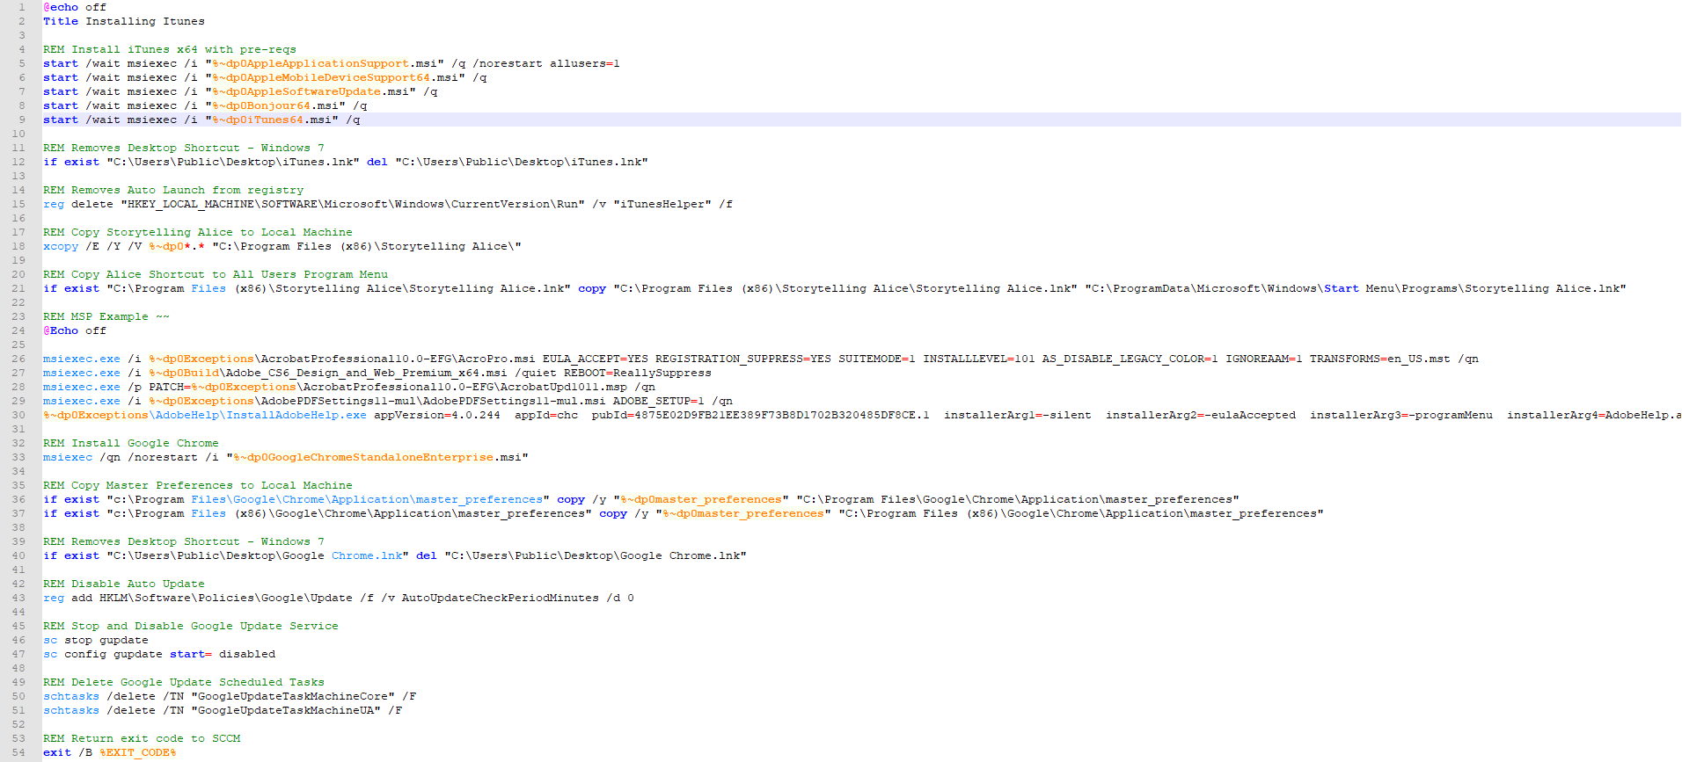
My Trusty Old BAT Cheatsheet

Slide 32
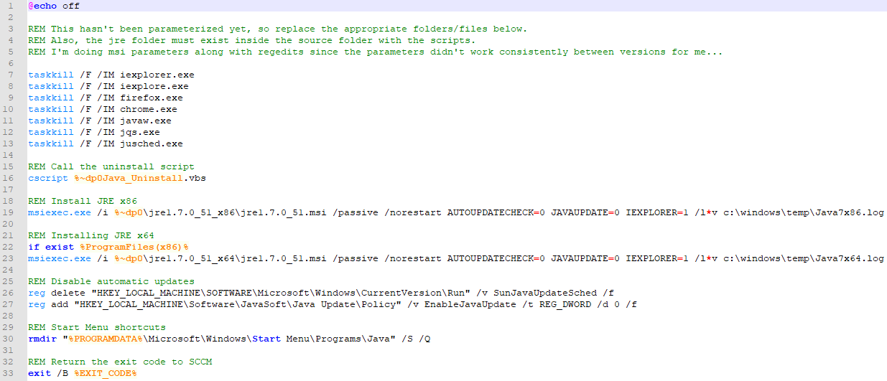
My Old Java Installer

Slide 33
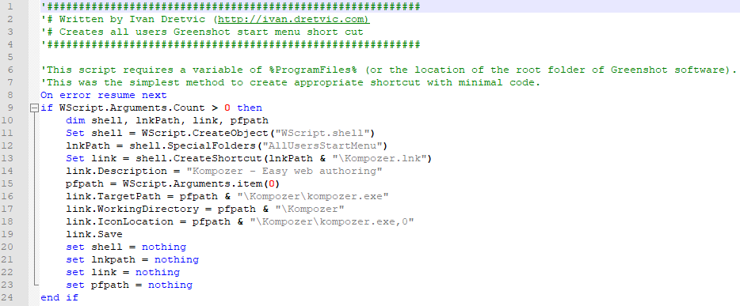
My Old Way To Create Start Menu Shortcuts

Slide 34
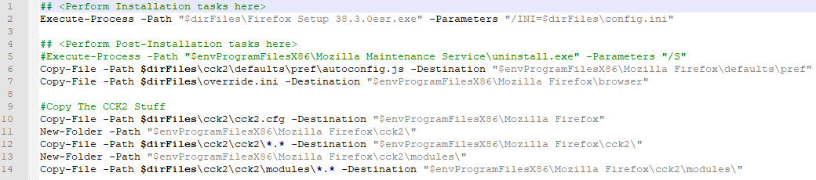
Firefox 38.3.0 ESR
Execute-Process, Copy-File, New-Folder, Uninstalling non-MSI Applications CODE: https://pastebin.com/6QxKiYp3

Slide 35
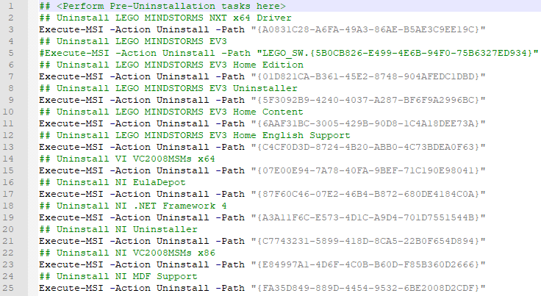
Lego Mindstorms EV3 1.1.1
Execute-Process, Execute-MSI, Post-Install Cleanup (1 installer requires 11 uninstallers for full cleanup) Get-WmiObject -Class Win32_Product -Filter "InstallDate = '20190318’” CODE: https://pastebin.com/ygAZPpcX
Jeffery Hicks - @JeffHicks - MORE WMI DATES – WIN32PRODUCT INSTALLDATE

Slide 36
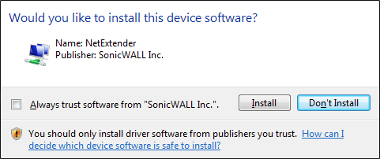
Sharp Panel Pen Drivers & Software – 1/2
Execute-Process, Execute-MSI, Show-InstallationPrompt (Required User Interaction), Remove-File Install Certificate InstallShield Record Installation and Uninstallation http://unattended.sourceforge.net/installers.php RECORD: /r Copy: c:\windows\setup.iss USE: /s /sms install.iss/uninstall.iss CODE: http://pastebin.com/ZTxViEuj
Silent Installation of Certificates and Device Drivers

Slide 37
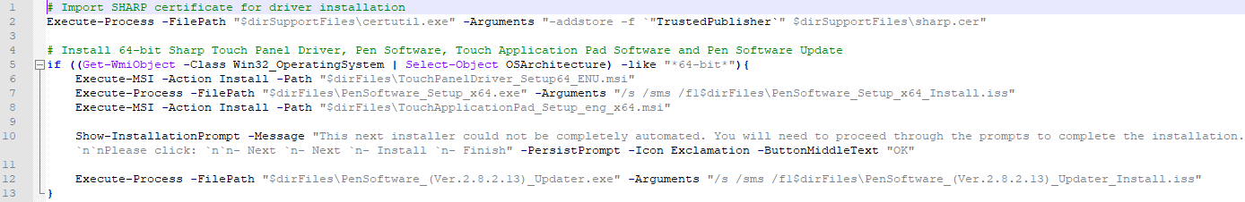
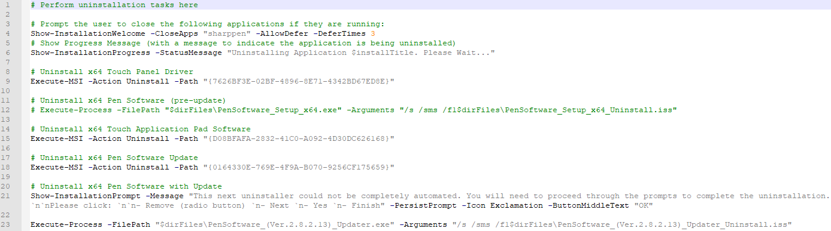
Sharp Panel Pen Drivers & Software – 2/2
CODE: http://pastebin.com/ZTxViEuj

Slide 38
Wacom Bamboo Tablet 5.3.5-3
Post-Install Cleanup (if installer provides no opt-out for plug-ins) Get-WmiObject -Class Win32_Product -Filter "InstallDate = '20190318’” CODE: https://pastebin.com/6QxKiYp3
Should I Remove It? - WebTablet FB Plugin

Slide 39
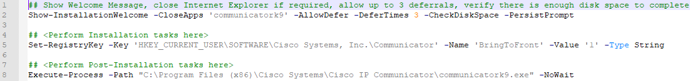
Cisco IP Communicator - BringToFront
Non-Standard Usage - Workstation Tweaks CODE: https://gist.github.com/chrisATautomatemystuff/57c79632c1682f32af826affa6fcf42c

Slide 40
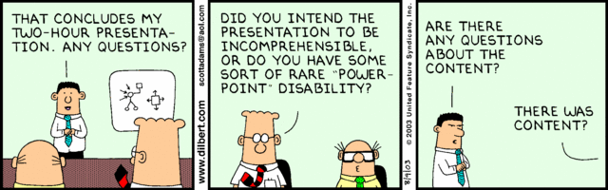
The End
https://tiny.cc/MISCUG-PADT

